Slide 1
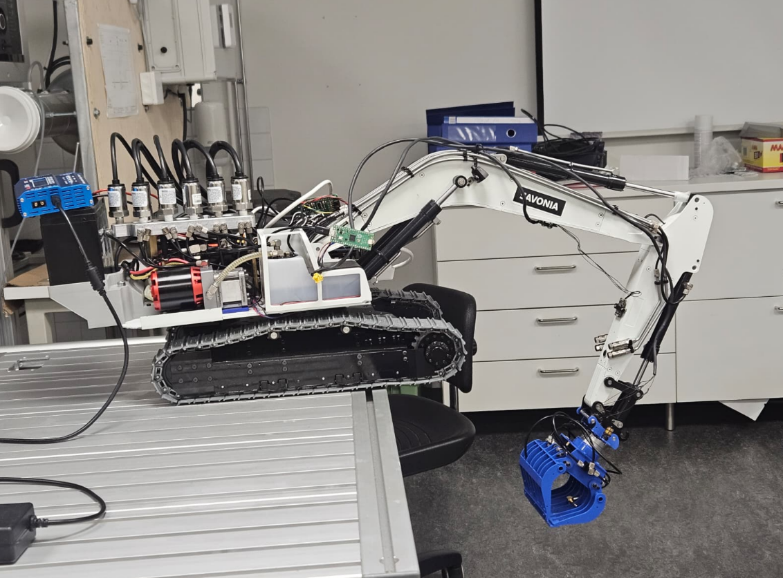

Slide 2
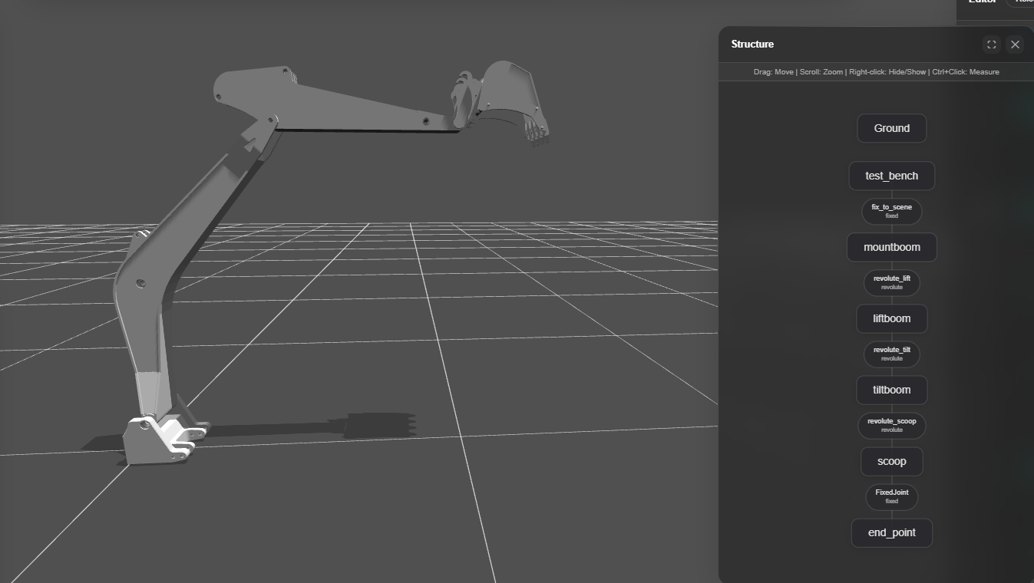

Slide 3
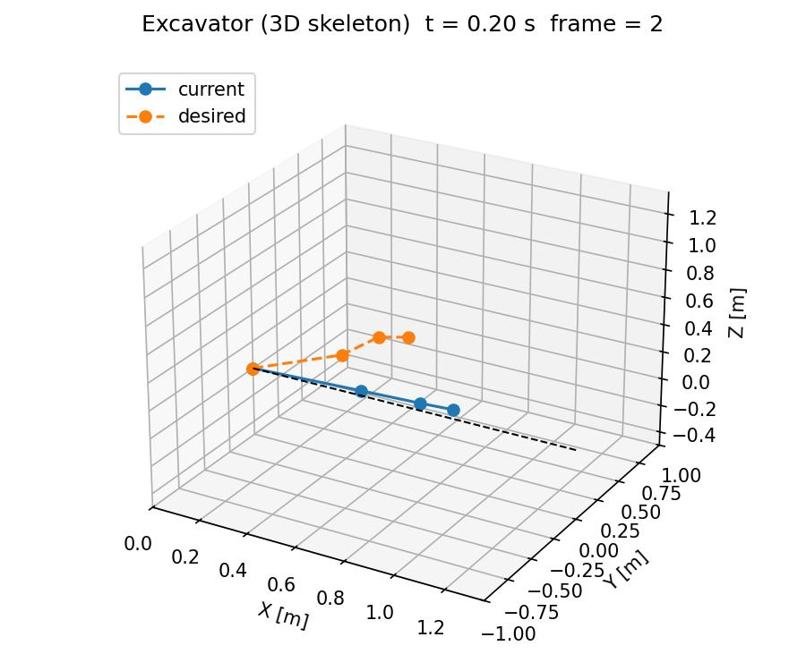
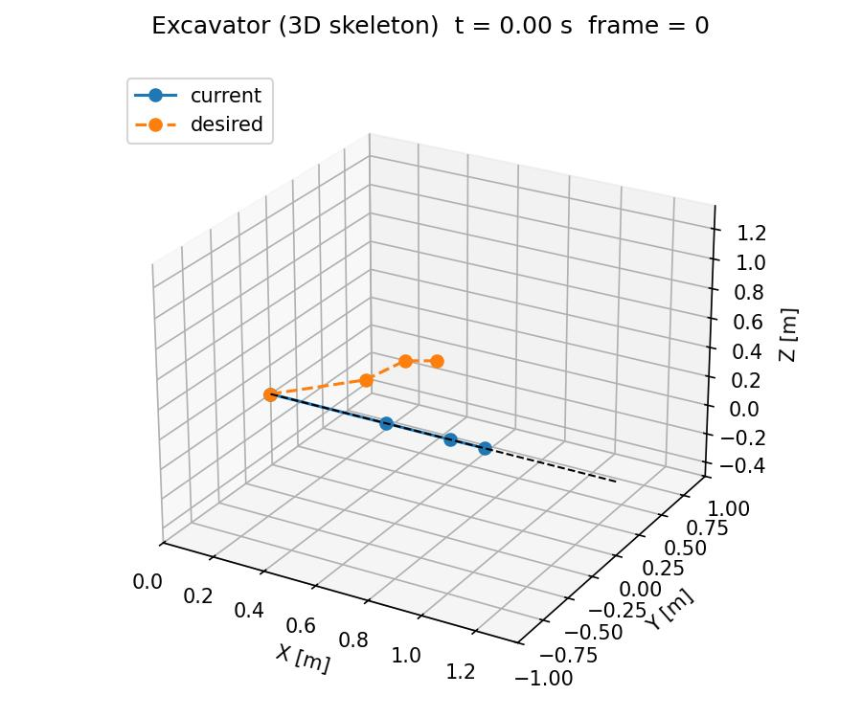



Slide 4
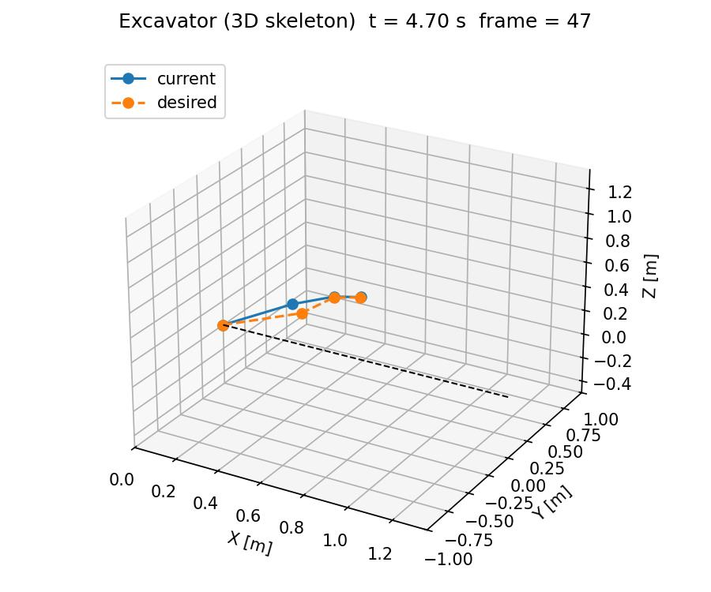




Slide 5
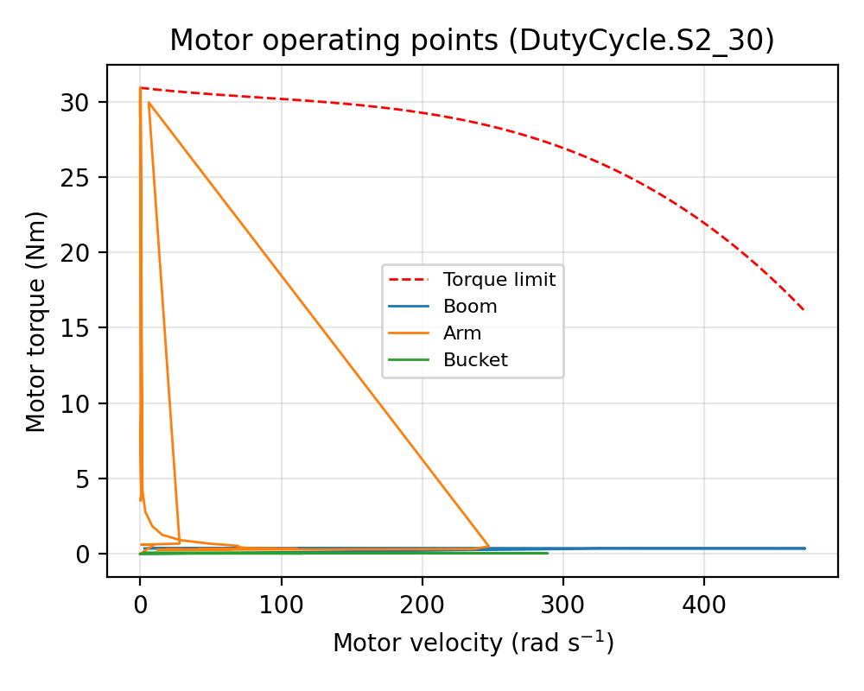
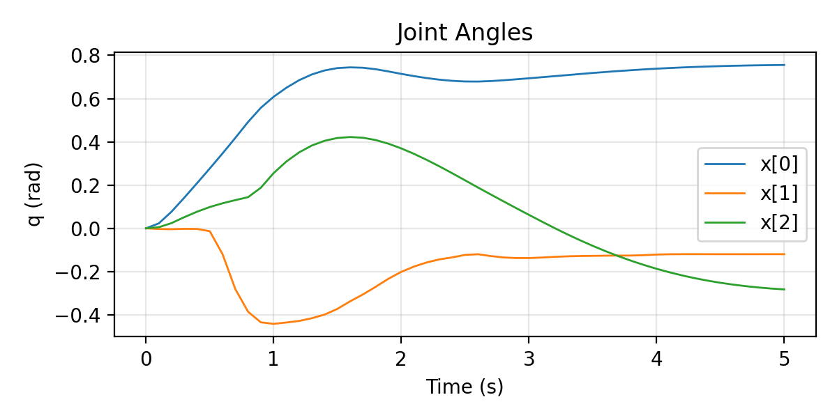
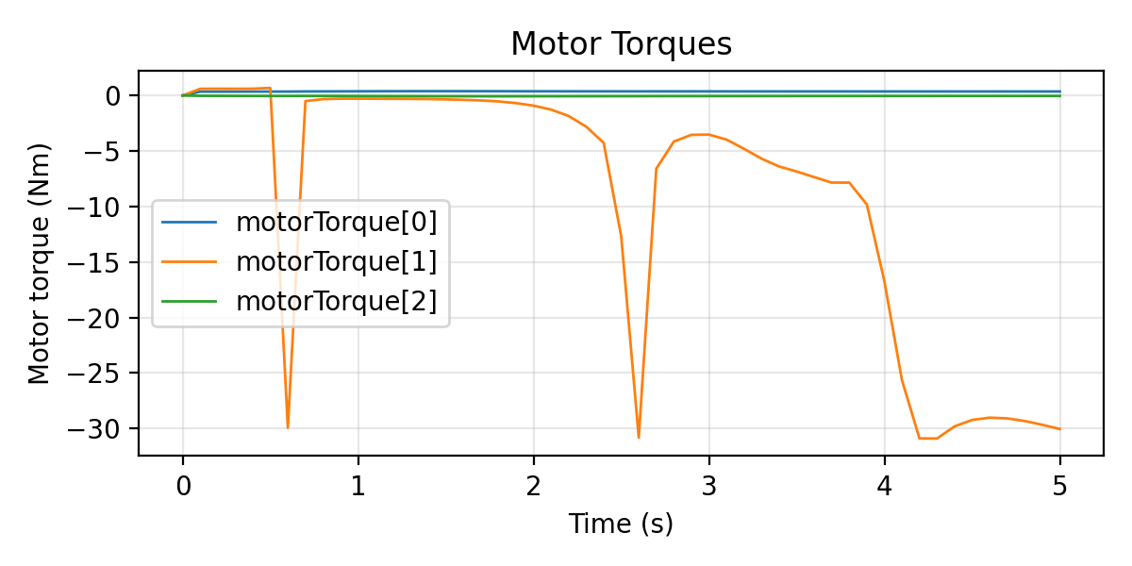
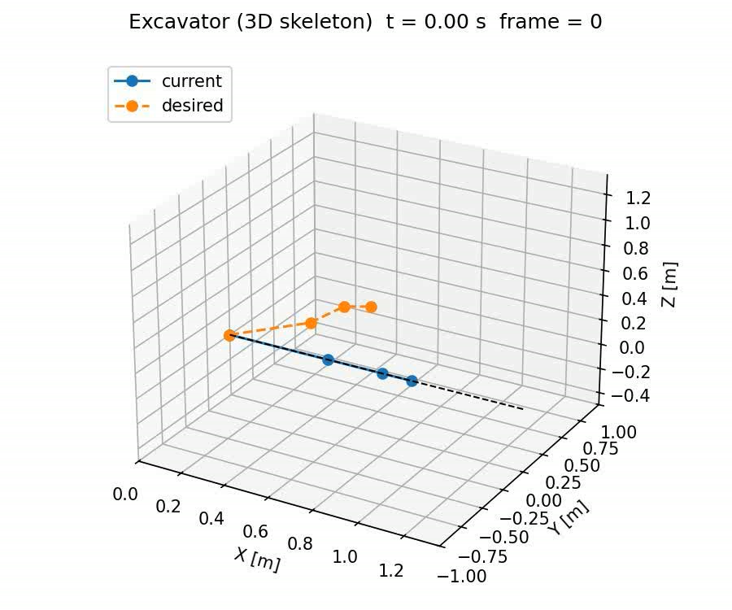
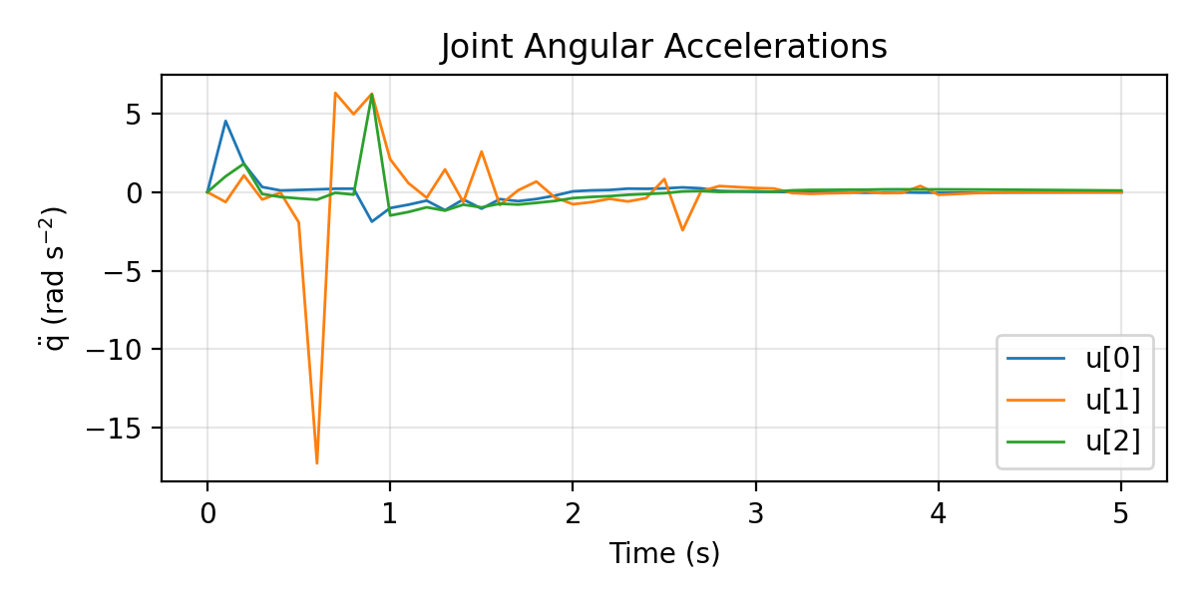
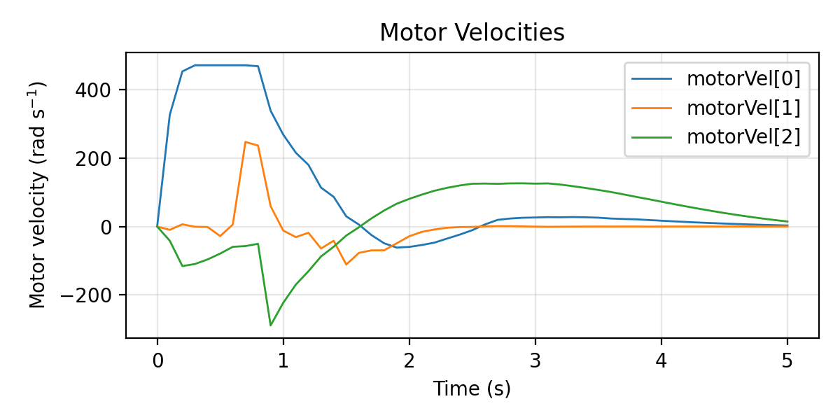

Slide 6
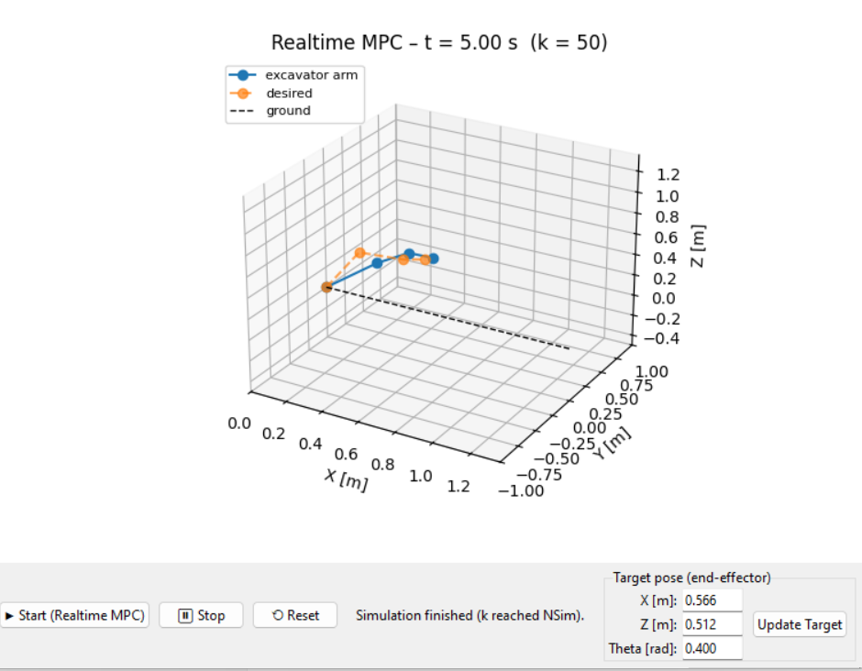
Test2 update the position

Slide 7
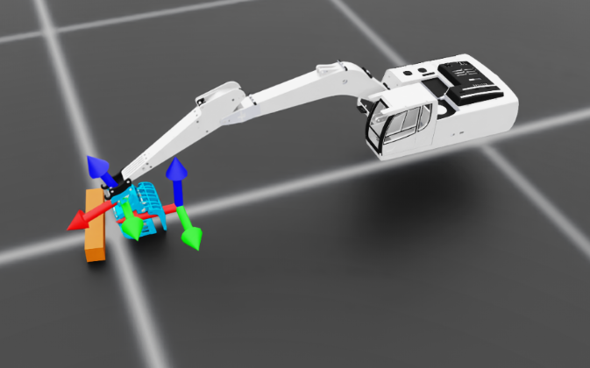
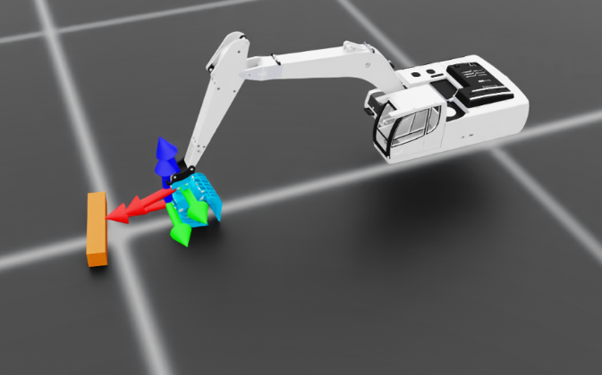
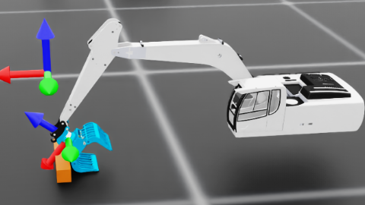
Episode_Reward/action_rate: 0.0000
Metrics/ee_pose/position_error: 0.0680

Slide 8
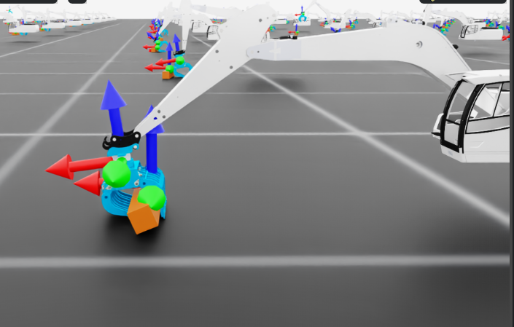
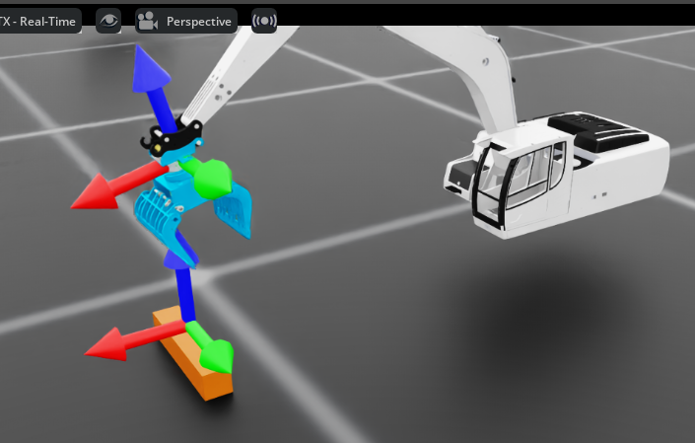
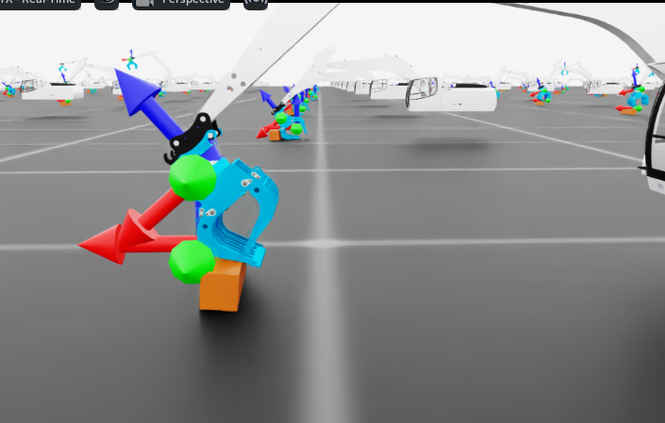

Slide 9
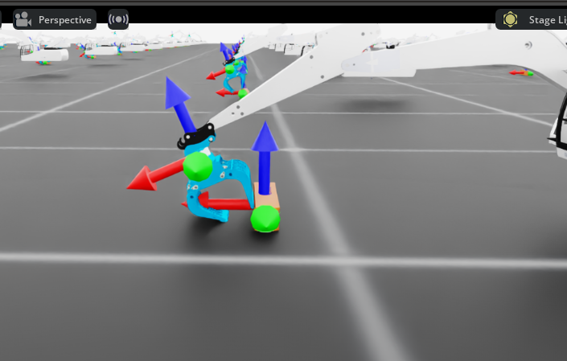
The current issue is that when the claw encounters an obstacle, it doesn't descend vertically. Could we modify the logic so that when the claw attempts to move forward, it shifts downward once it reaches a certain distance from the target point (log)? This way, log would be directly beneath the claw. As the claw wraps around the target, it would exert upward force to lift it.
sync_command_with_log = EventTerm( func=mdp.sync_ee_pose_to_log_center, mode="interval", interval_range_s=(0.0, 0.0), # 每步更新 params={ "command_name": "ee_pose", "robot_asset_cfg": SceneEntityCfg("robot"), "log_asset_cfg": SceneEntityCfg("log"), "z_offset": 0.0, # 目标=log中心；如果想抓上表面可设 0.02 },

Slide 10
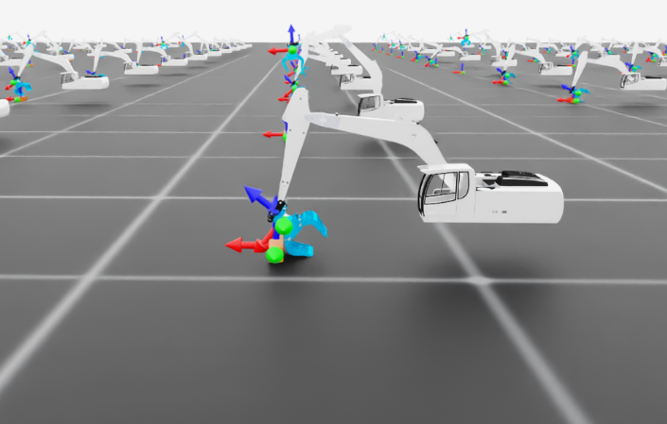
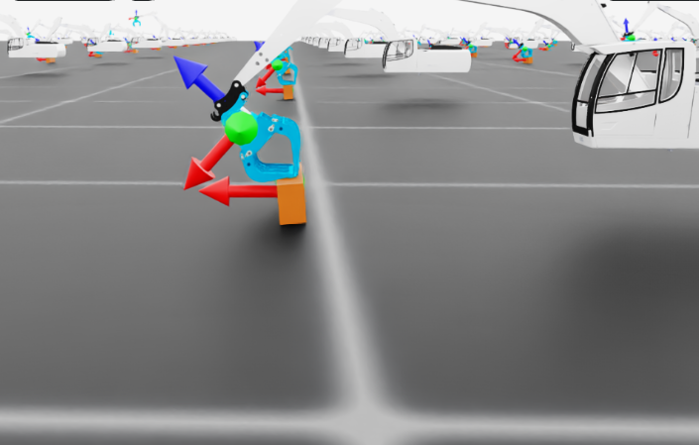
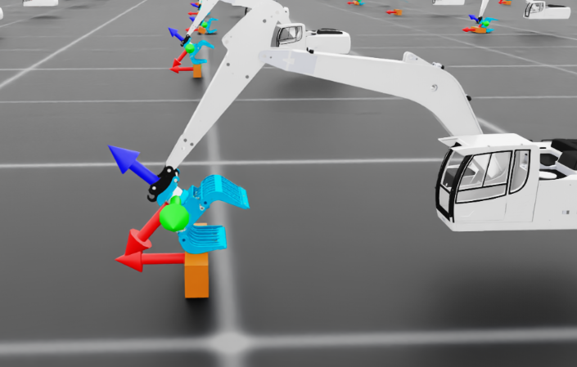
夹爪关节 limit 本来就没到 0.6rad（被物理限位 clamp 了）

Slide 11
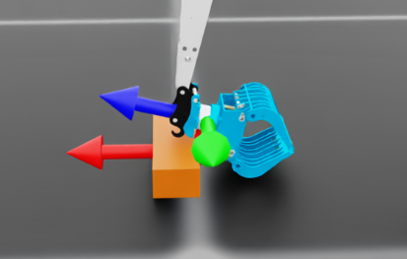
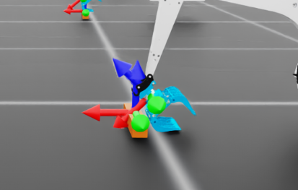
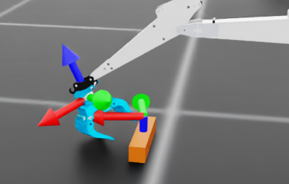
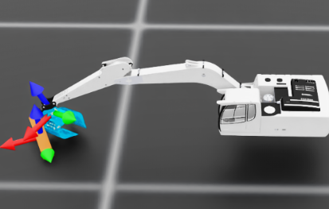
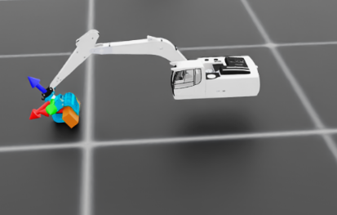
Align with object

Slide 12
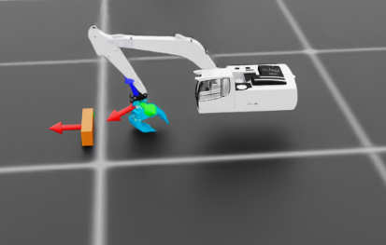
ik_rel_log_env_cfg copy 8 after align ok .py

Slide 13
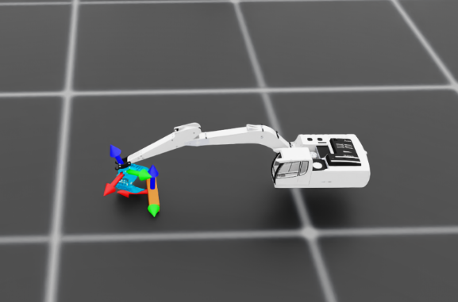
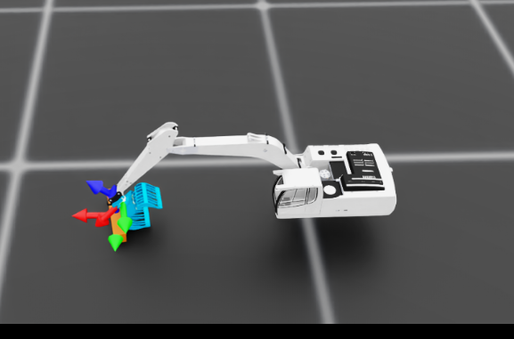
Learning iteration 91/5000
Computation: 4961 steps/s (collection: 2.357s, learning 0.062s)
Mean action noise std: 0.60
Mean value_function loss: 0.0008
Mean surrogate loss: -0.0027
Mean entropy loss: 6.3417
Mean reward: -2.90
Mean episode length: 360.00
Episode_Reward/end_effector_position_tracking: -0.1712
Episode_Reward/end_effector_position_tracking_fine_grained: 0.1862
Episode_Reward/action_rate: 0.0000
Episode_Reward/log_lift_reward: 0.1398
Episode_Reward/end_effector_orientation_tracking: -0.3976
Metrics/ee_pose/position_error: 0.1459
Metrics/ee_pose/orientation_error: 0.9408
Episode_Termination/time_out: 0.9811
Episode_Termination/root_oob: 0.0000
Episode_Termination/ee_speed_oob: 0.0000
Episode_Termination/any_link_speed_oob: 0.0189
Episode_Termination/any_link_oob: 0.0000
Episode_Termination/nan_inf_guard: 0.0000
--------------------------------------------------------------------------------
Total timesteps: 1104000
Iteration time: 2.42s
Time elapsed: 00:03:36
ETA: 03:12:25
masi_v9.zip

Slide 14
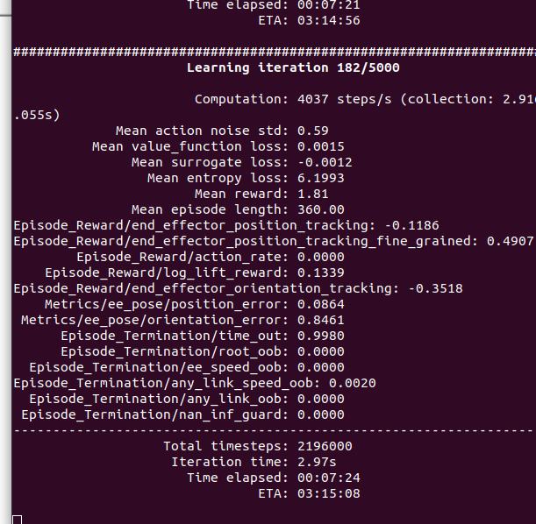
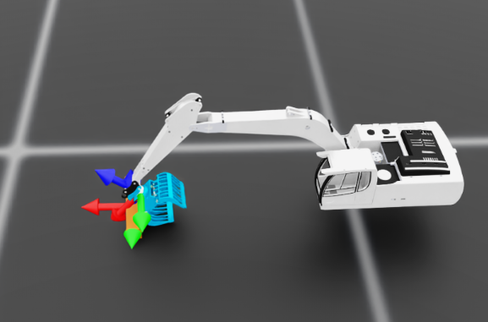
masi_v9.zip

Slide 15
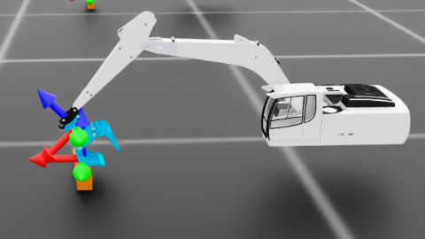
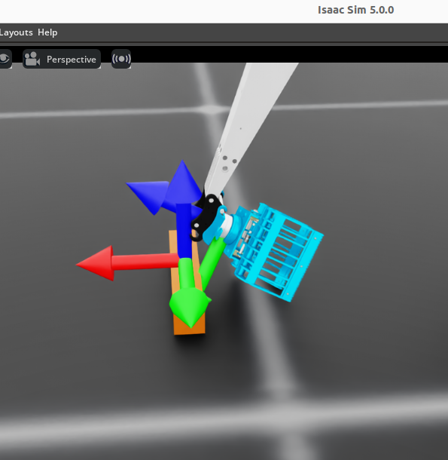
v 9
Lets try
body_offset=DifferentialInverseKinematicsActionCfg.OffsetCfg( # 关键改动：把“虚拟末端”从 gripper_frame 向下挪一段到铲斗前端 # 数值你可以微调，先试 -0.25，如果目标点还在铲斗中间就再缩小一点 pos=[0.0, 0.0, -0.19], # v9 pos=[0.0, 0.0, -0.19], rot=[0.7071068, 0.0, 0.7071068, 0.0], # v9 绕 Y 轴 +90° ), )

Slide 16
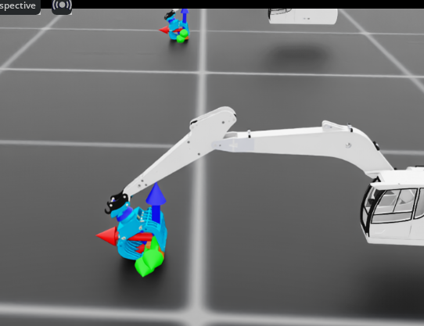
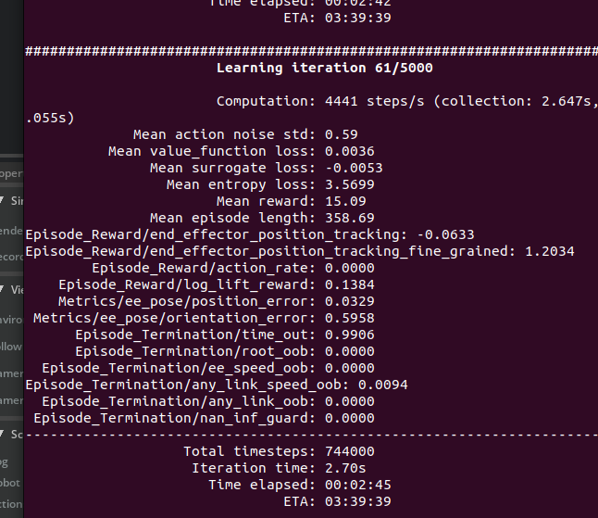
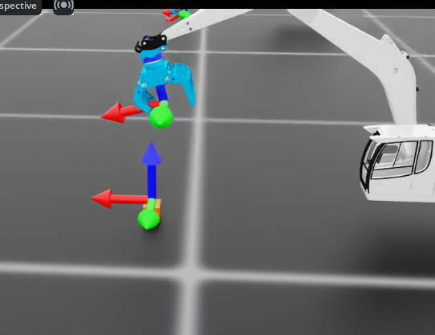
- body_name="gripper_frame",
+ body_name="ee",

Slide 17
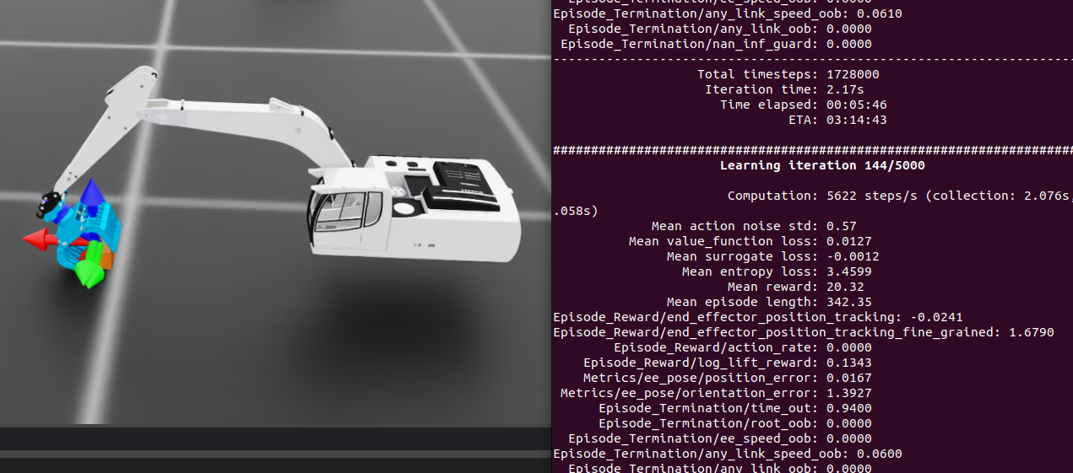
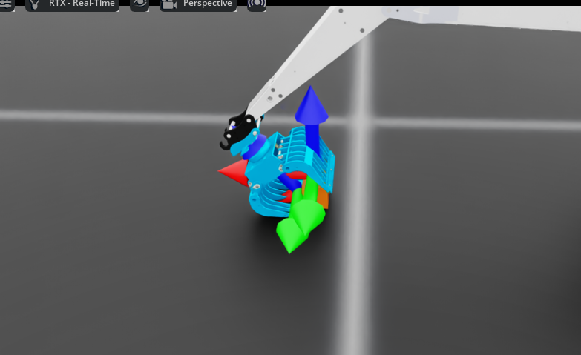
Save v10 version for this modify
Has contained the log but cannot catch and lift it
The current training phase is such that when the claw wraps around the log target, it does not immediately grasp the object. Instead, it continues pushing the object until the claw can no longer wrap around it.
"close_dist": 0.02,
+"close_dist": 0.05, # 先从 5cm 开始
"keep_open_xy": 0.10,
+"keep_open_xy": 0.06, # 对齐要求更严格，否则老是强制张开
"keep_open_z_above": 0.02,
+"keep_open_z_above": 0.01 # 离得不高了就允许夹

Slide 18
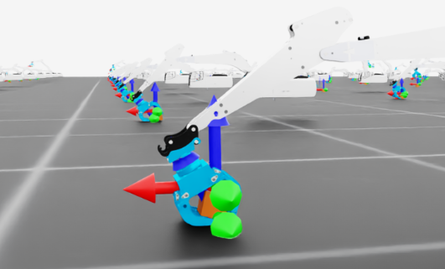
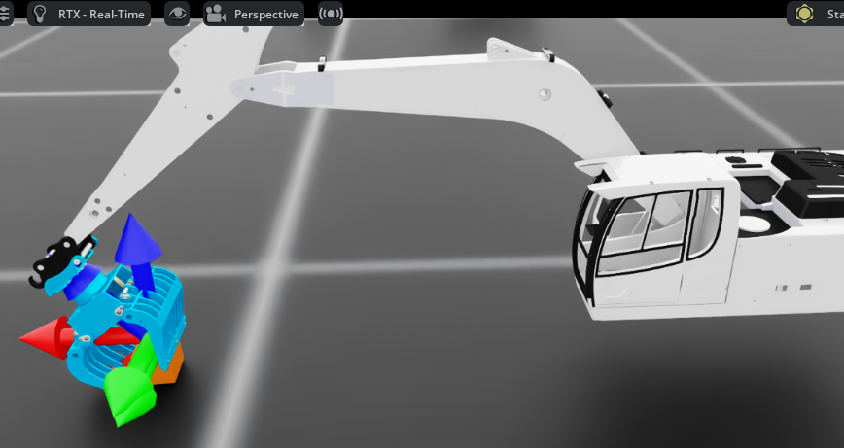
masi_V11
Can contain and grasp but cannot lift
masi_v12.zip
masi_v13.zip

Slide 19
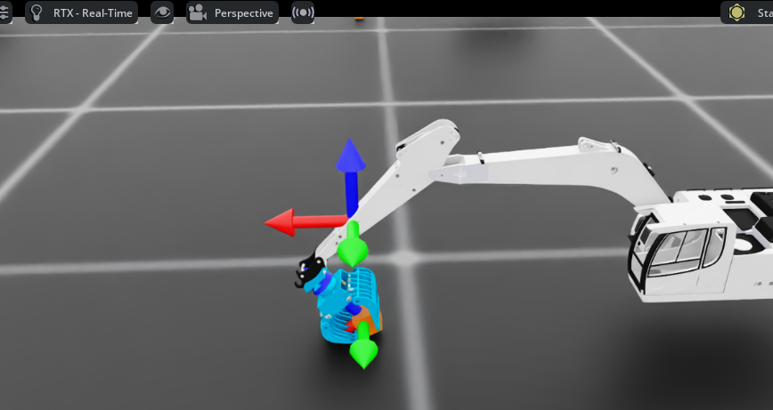
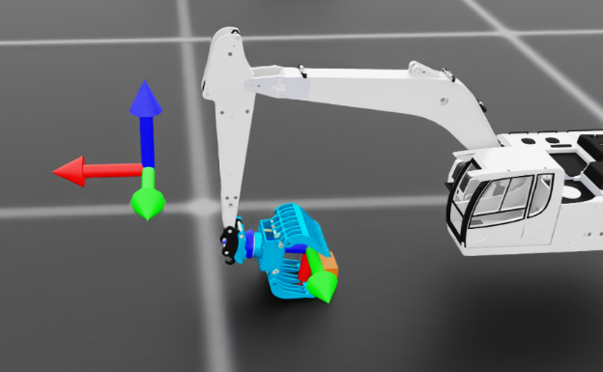
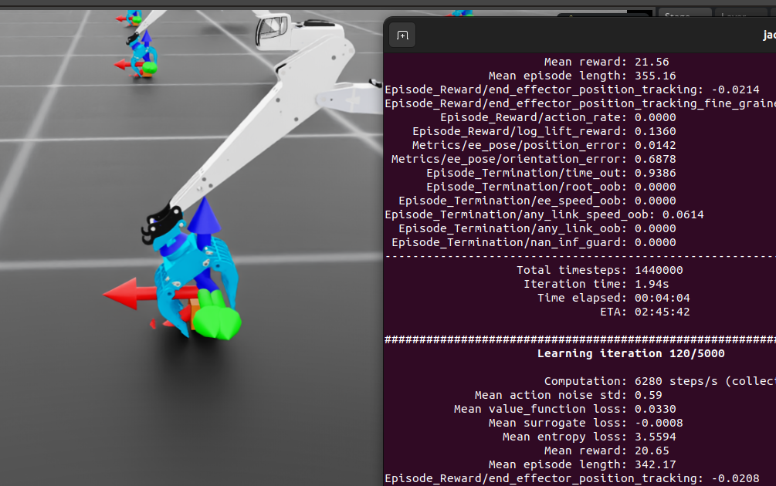
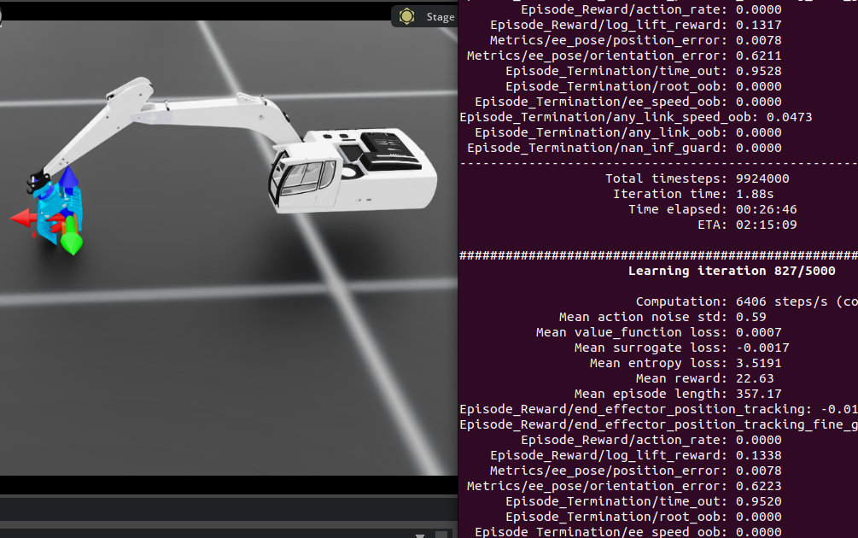
masi_v14.zip
Modified: When the log is wrapped, it moves upward, but the claw remains firmly gripped on the log entity.
Can contain and grasp but cannot lift

Slide 20
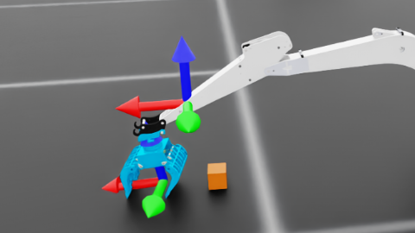
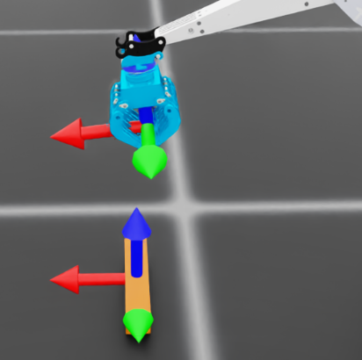
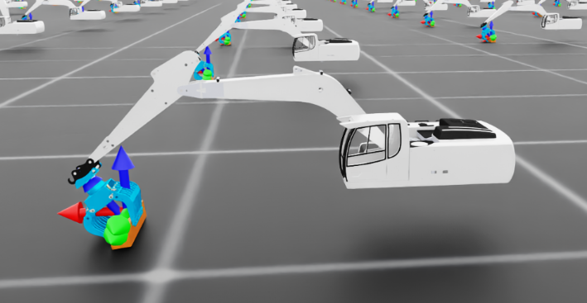
masi_v15.zip
Modified: When the log is wrapped, it moves upward, but the claw remains firmly gripped on the log entity.
Eetu help check the model (17.12.2025)
19.12.2025:
masi_v17 recovery for this version
The target has already soared halfway up, yet its claws still scrape the ground.

Slide 21
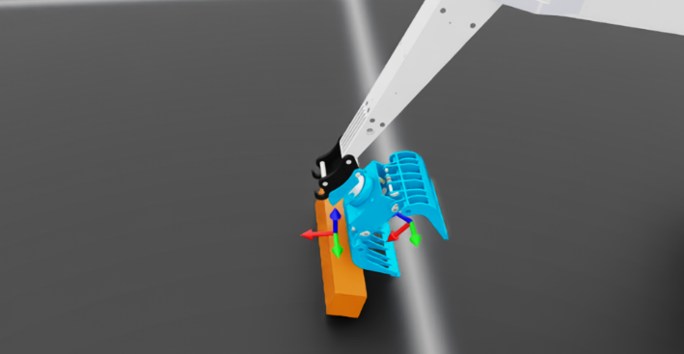
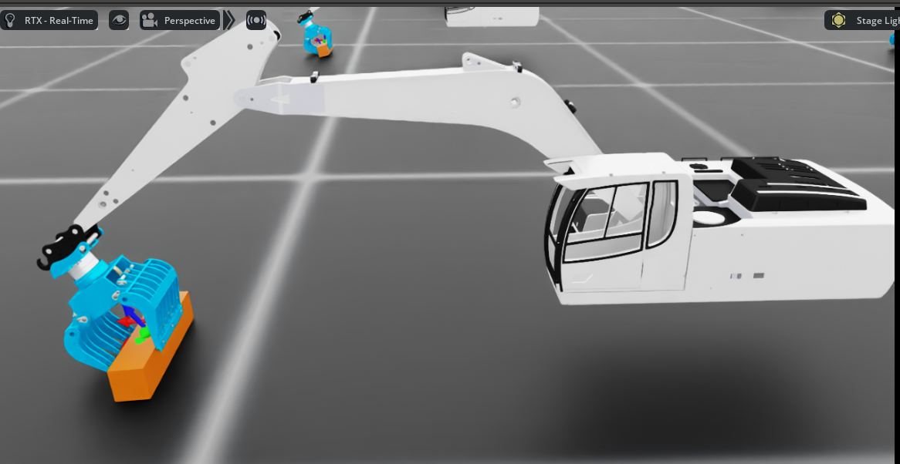

masi_v18.zip
masi_v15.zip
Modified: When the log is wrapped, it moves upward, but the claw remains firmly gripped on the log entity.

Slide 22

[ActionTerms] ['arm_action', 'gripper_action']
[ActionDims ] [3, 1]
[GripSlice ] slice(3, 4, None)
[ActionTerms] ['arm_action', 'gripper_action']
[ActionDims ] [3, 1]
[GripSlice ] slice(3, 4, None)
[DBG] claw_joint_ids = [5, 6]
[ActionTerms] ['arm_action', 'gripper_action']
[ActionDims ] [3, 1]
[GripSlice ] slice(3, 4, None)
[DBG] claw_joint_ids = [5, 6]
[DBG] claw joint_pos = [0.058184847235679626, -0.05750758945941925]
[DBG] claw joint_pos_target= [0.800000011920929, -0.800000011920929]
[DBG] phase(eid) = 0

Slide 23
masi_v18_1 just stable than before

Slide 24
base ≈ test_bench（或者 test_bench + mountboom 这一块底座）
boom ≈ liftboom（第一节大臂，负责 lift）
arm ≈ tiltboom（第二节小臂，负责 tilt）
bucket ≈ scoop（铲斗）
tip ≈ end_point（末端点）
test_bench ──fix_to_scene──> mountboom
└─(revolute_lift)──> liftboom ← 对应原来的 boom 关节（jointBoom）
└─(revolute_tilt)──> tiltboom ← 对应原来的 arm 关节（jointArm）
└─(revolute_scoop)──> scoop ← 对应原来的 bucket 关节（jointBucket）
└─FixedJoint──> end_point ← 对应原来的 tip
<joint name="revolute_tilt" origin="0.20564 0 0.420085" parent="liftboom" child="tiltboom"/>
<joint name="revolute_scoop" origin="0.25 0 0" parent="tiltboom" child="scoop"/>

Slide 25
outline
Topic
Goals
Plans
Study resource/ code

Slide 26
Thesis topic
Simulation-based development for a nonlinear excavator system
(with emphasis on practical feasibility and flexible model choice)

Slide 27
Research Goals
1.Use provided excavator model or similar excavator model from open resource to build environment
2. model-based learning model or reinforcement learning model
3.generate a simulation demo for illustrative tasks (such as log lifting or trajectory tracking).
4.optionally implement and compare different control strategies on simulator environment, such as MPC vs PID;

Slide 28
Phase | Main tasks | Timeframe (08.12.2025~1.02.2026)
Planning | Finalise topic, agree responsibilities, write and approve work plan (including analysing the feasibility) | Month 1(December)
Simulation setup | Integrate excavator model, implement dynamics, set up training environment. | Month 1(December)
Controller implementation | Implement a Baseline controller or MPC or learning-based controllers on simulation environment | Month 2(January)
Experiments and analysis | Run simulations, collect data, evaluate performance | Month 2(January)
Writing and finalisation | Write results, discussion, conclusions, revise with supervisor | Month 3(February)

Slide 29


study cases
https://github.com/simscape/Excavator-Simscape
https://github.com/xuexianlim/eXactMPC

Slide 30


https://github.com/mathworks-robotics/autonomous-excavator
https://github.com/leggedrobotics/rsl_heap
https://viewer.robotsfan.com/

Slide 31


http://bilibili.com/video/BV1jG4y1h7KU/?vd_source=d039de0562f9406b58c45a447595a8b6
# other models
https://github.com/eyhxh/3Dprint-mini-RC-excavator
https://github.com/swholmstead/Excavator

Slide 32
Thanks

